Slide 1
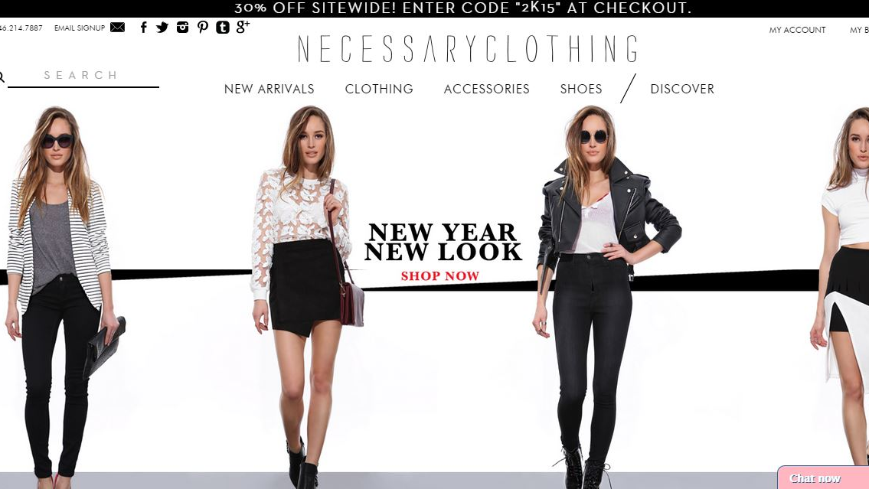
What do consumers look for when they shop online?
Ahmad Saquib Sina
Major: Retail Merchandising
Focus: Online technology

Slide 2

Introduction Average sales growth 12.3% per year. Total sales is a 17.2% market share of total US retail e-commerce.

Slide 3
Purpose Cast light on what consumers’ look for when they shop online. Explore the perception of online shopping experience with three online consumers.

Slide 4
Research questions
Factors that consumer look for
Preferences
Recent changes/developments
Challenges/difficulties
How they decide
Suggestions

Slide 5

Role of the researcher
Objectivity
Reveal myself through self-reflexivity

Slide 6

Method
Participants
Procedure
Materials and approach
Interview questions

Slide 7
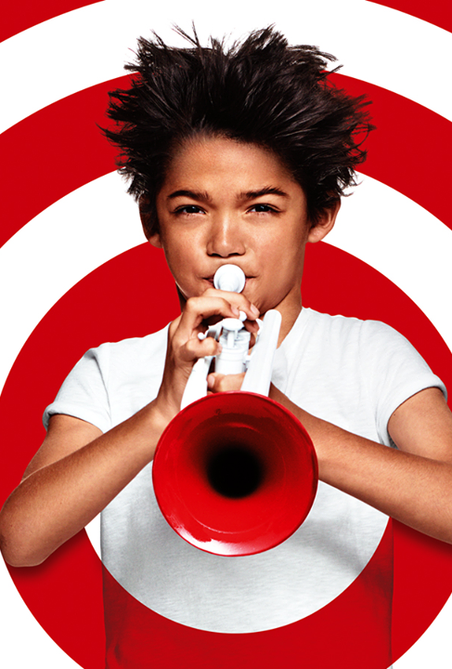
Participants
Three young women (18-22 years)
Experience of 10 to more than 50 times
Amazon, Von Maur, JC penny, and Younkers
$500 to over $1000 annually
Snowball sampling

Slide 8

Procedure
Three in-depth semi-structured interviews
Time- February-March
Setting- McNeal Hall, U of M
Theme- Look for repeated words
Peer review (Nika and Robbie)

Slide 9

Approach
Qualitative – emphasizes discovery and description
Interpret the meaning of experience
Phenomenology study
To arrive at a description of the nature of phenomenon

Slide 10

Interview questions
Tell me how your experience began ?
Observation
Using neutrality
Asking for details rather than lot of questions.
Using probes.

Slide 11

Convenience
Quote - “I can easily get the apparel items when I shop online. The items are always in the stock (Kierra).”
Enjoyable
Easy to access
Whenever and whatever they
want

Slide 12

Why Convenience so important
Well informed
Update- Facebook, Instagram, and email
24/7 shopping
Pollution free
Crowding

Slide 13
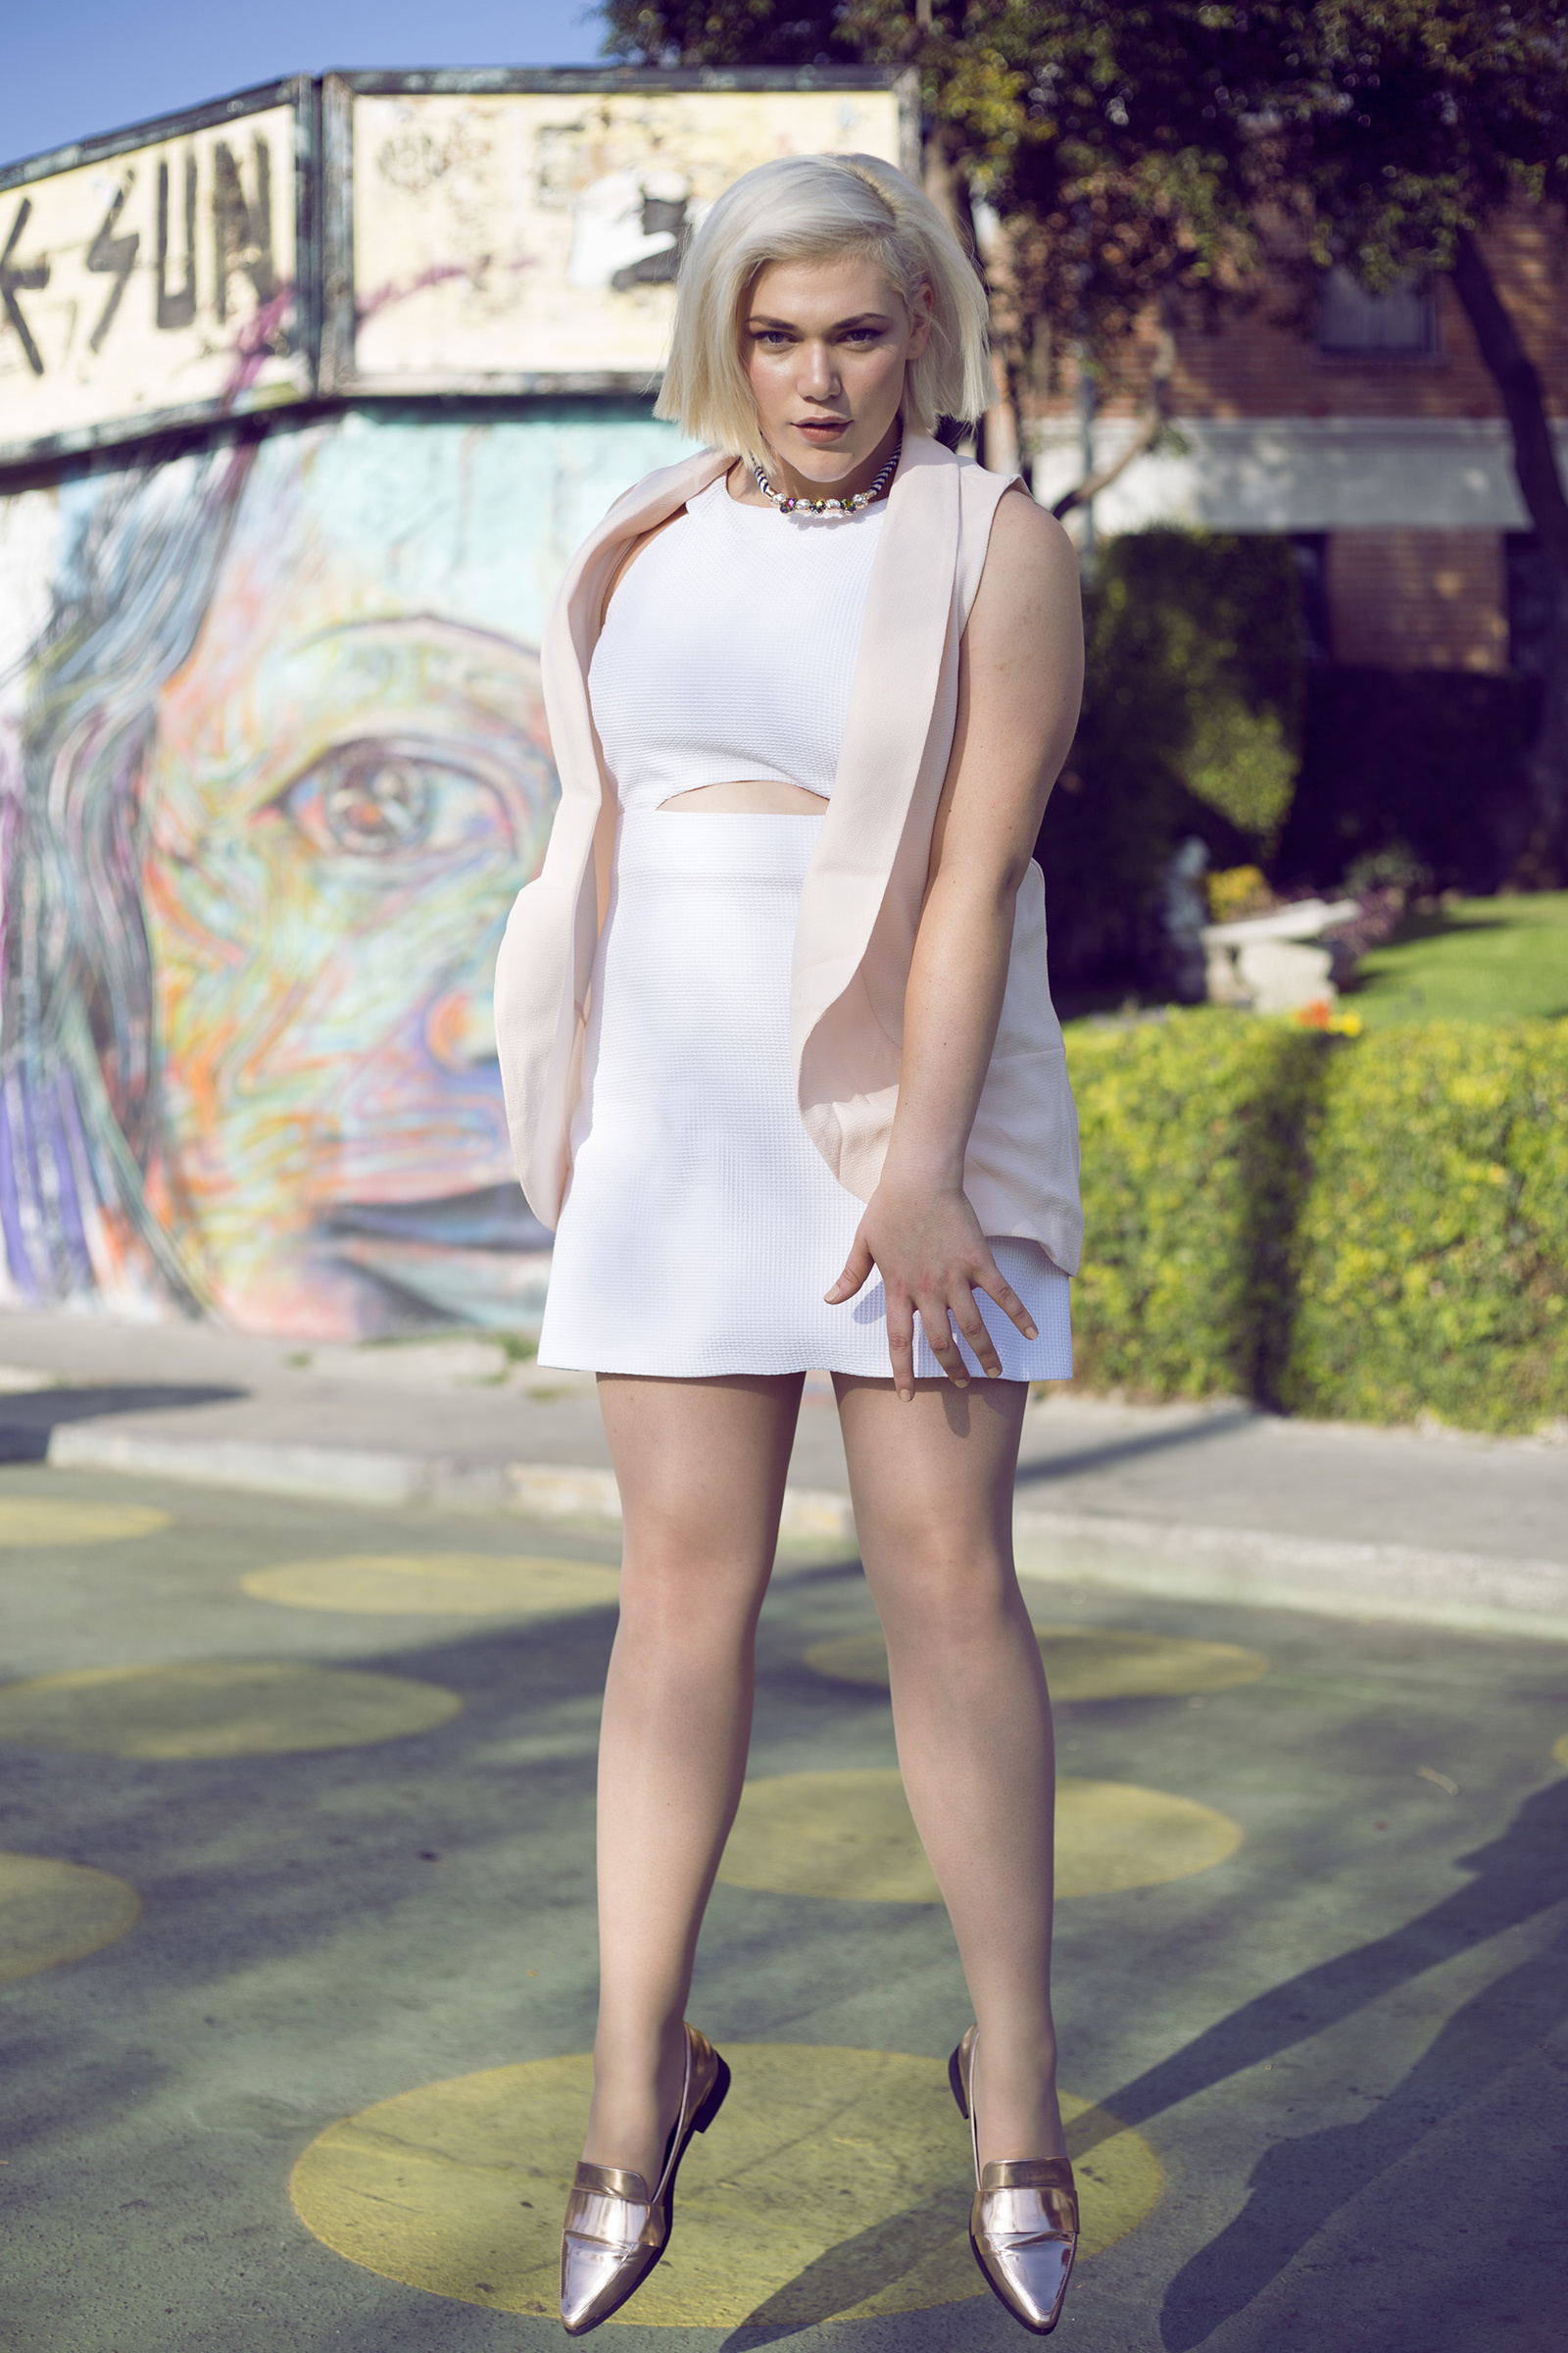
Video of a natural walking model
“I look for a certain model, the model who is walking and who looks like me (Kierra).”
Better choice
Feels- I am walking

Slide 14
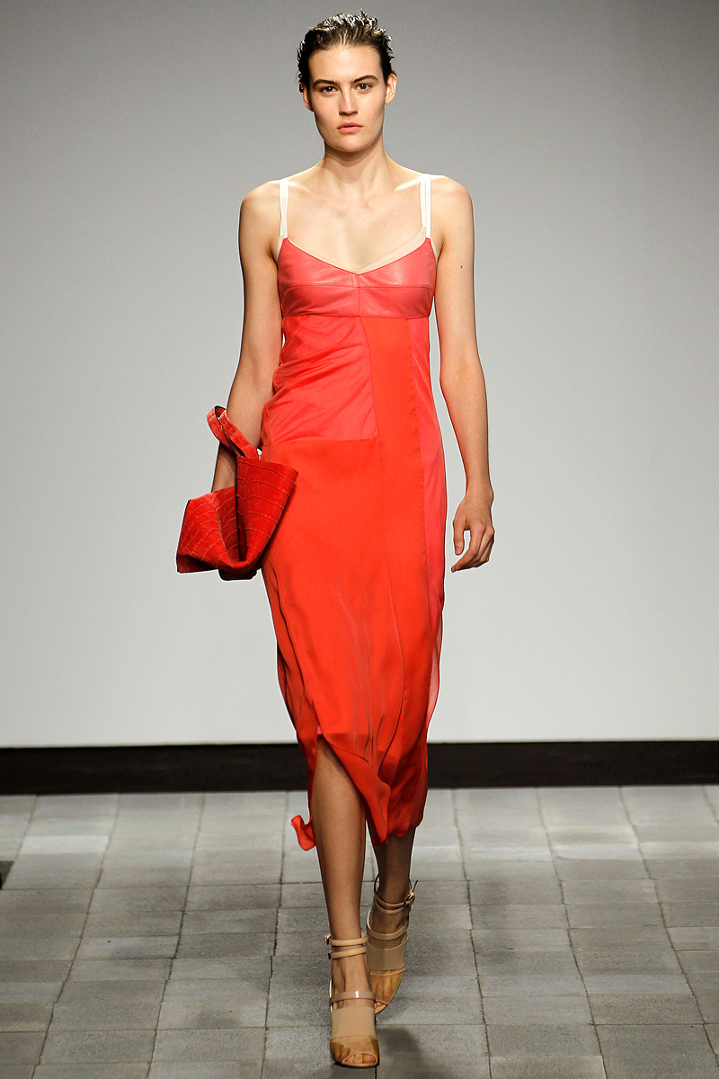
Why video of a walking model so important
Get more information of an apparel item.
Better guess of an apparel item.
They can know what they look like.

Slide 15
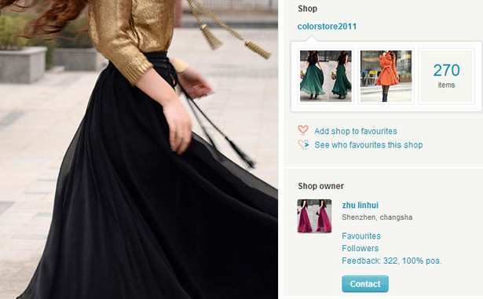
Photographs with multiple angles of an apparel item and zooming
“I always look for the product movement and zooming functions on an online site. This is because I need to look for the color, texture and the size (Megan)"
Capture attention
Pleasurable experience

Slide 16
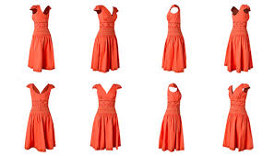
Why Photographs with multiple angles of an apparel item and zooming so important
Reduces the perceived risk.
Cannot touch the product
Feels that they touch an item

Slide 17

Good return policy
“I like Amazon just because they do not have any questions about returns. I can order whatever I need and want to look at and if it does not fit, I can take it back or send it back (laughs) (Megan).”
Some items are not so good.
One of the most important factors.

Slide 18

Why a good return policy so important
Guarantee
Satisfaction
Avoid online apparel shopping

Slide 19
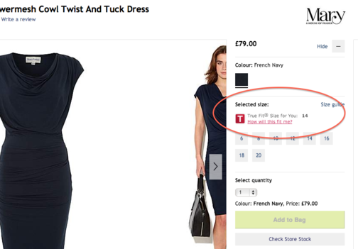
Fit and size of an apparel item
“I like my online shopping from Nordstrom because I am experienced with this online site. I know everything about it, and I know exactly the size I want (Megan).”
Concerning point
Experienced site

Slide 20
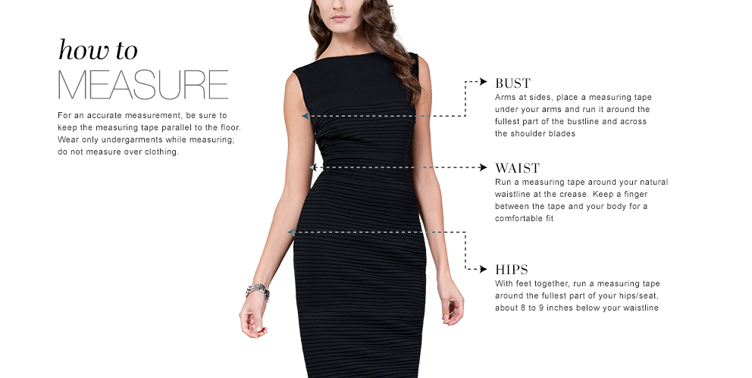
Why fit and size so important
Can not try on them.
Based on retailers information.
Accustomed site.
Know about it.

Slide 21

Limitations
Restricted sample
Limited generalizability
Triangulation
Participant reactivity
Subjectivity- depends on the researcher.

Slide 22

Implications
Convenience – Increase Market
share.
Walking model- Informative
displays.
Product movement and
zooming- mitigate risks
Good return policy- Consumers
loyalty.
Size and feet – Customization
technique.

